Slide 1

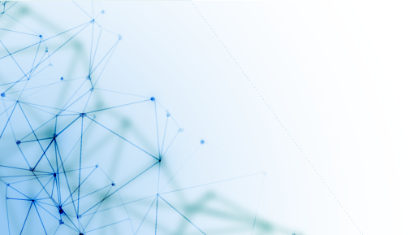
Web Scraping
What is Web Scraping?
Uses of Web Scraping
Notebooks

Slide 2

What is Web Scraping?
- The dictionary meaning of word ‘Scrapping’ implies getting something from the web. Here two questions arise: What we can get from the web and How to get that. The answer to the first question is ‘data’. Data is indispensable for any programmer and the basic requirement of every programming project is the large amount of useful data.
- The answer to the second question is a bit tricky, because there are lots of ways to get data. In general, we may get data from a database or data file and other sources. But what if we need large amount of data that is available online? One way to get such kind of data is to manually search (clicking away in a web browser) and save (copy-pasting into a spreadsheet or file) the required data. This method is quite tedious and time consuming. Another way to get such data is using web scraping.
- Web scraping, also called web data mining or web harvesting, is the process of constructing an agent which can extract, parse, download and organize useful information from the web automatically. In other words, we can say that instead of manually saving the data from websites, the web scraping software will automatically load and extract data from multiple websites as per our requirement.

Slide 3
Uses of Web Scraping
The uses and reasons for using web scraping are as endless as the uses of the World Wide
Web. Web scrapers can do anything like ordering online food, scanning online shopping
website for you and buying ticket of a match the moment they are available etc. just like
a human can do. Some of the important uses of web scraping are discussed here:
- E-commerce Websites: Web scrapers can collect the data specially related to the
price of a specific product from various e-commerce websites for their comparison.
- Content Aggregators: Web scraping is used widely by content aggregators like
news aggregators and job aggregators for providing updated data to their users.
- Marketing and Sales Campaigns: Web scrapers can be used to get the data like
emails, phone number etc. for sales and marketing campaigns.
- Search Engine Optimization (SEO): Web scraping is widely used by SEO tools
like SEMRush, Majestic etc. to tell business how they rank for search keywords that
matter to them.
- Data for Machine Learning Projects: Retrieval of data for machine learning
projects depends upon web scraping.
Data for Research: Researchers can collect useful data for the purpose of their research
work by saving their time by this automated process.

Slide 4
Notebooks:
https://github.com/omaaralaa/Microsoft-Student-Club-DS/tree/main/Web%20Scraping

Slide 5

THANK YOU
Data Science Team

